Slide 1
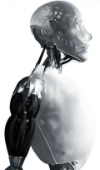
my other robot is an
NS-5
my other robot is an
NS-5
my other robot is an
NS-5
my other robot is an
NS-5

